Slide 1

Credit Card Trend Analysis
Unveiling Credit Card Default Risk: Analyzing Trends, Relationships, and Predictive Insights

Slide 2
Problem Statement
The bank has issued credit cards extensively, including to unqualified applicants, to boost market share.
Many cardholders, regardless of their ability to repay, have accumulated substantial credit and cash-card debts through overuse.
This crisis has severely impacted consumer finance confidence, posing significant challenges for both banks and cardholders.
Estimating the probability of default is crucial for risk control, surpassing the simple classification of customers as risky or non-risky.
Goal

Slide 3

Data Collection
Data source: Client gave us the data through excel file.
The file contains details about
Amount of the given credit (NT dollar): This includes both the individual consumer credit and their family (supplementary) credit.
Gender: 1 = male; 2 = female.
Education: 1 = graduate school; 2 = university; 3 = high school; 4 = others.
Marital status: 1 = married; 2 = single; 3 = others.
Age: Years. History of past payment: Past monthly payment records (from April to September 2005) with values ranging from 0 to 9, where 0 = pay duly and 1-9 represent payment delays of one to nine months and above.
Amount of bill statement (NT dollar): Amount of bill statement in September, August, and April 2005.
Amount of previous payment (NT dollar): Amount paid in September, August, and April 2005.

Slide 4
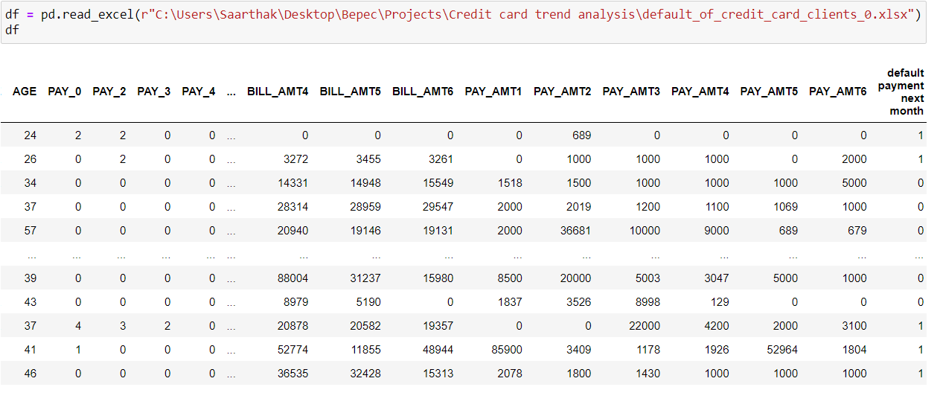
Data Preprocessing
Data

Slide 5
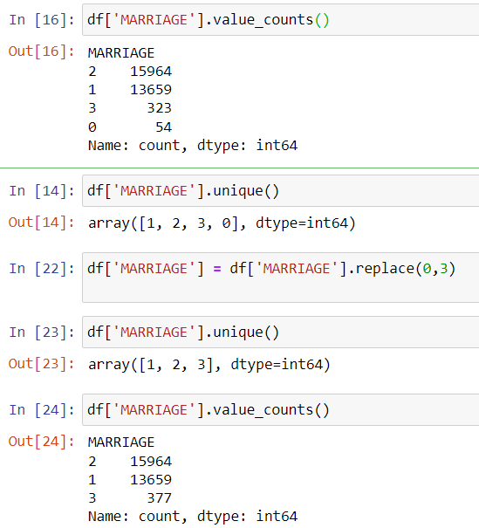
Data Preprocessing
Handling errors, missing values :
While looking at ‘MARRIAGE’ column , I found out that there are 4 categories instead of 3.An extra ‘0’ category was present, So I assumed three categories are enough and replaced ‘0’ by category ‘3’ as This category could include individuals who are widowed, divorced, separated, or in other non-standard marital situations that do not fit into the categories of '1' (married) or '2' (single).

Slide 6
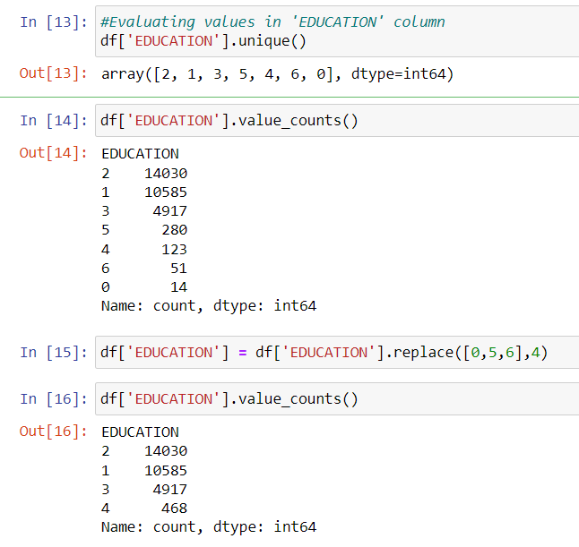
Data Preprocessing
In ‘AGE’ column we have 7 categories instead of 4 .So, putting category ‘5’, ‘6’, ‘7’, ‘0’ in category ‘4’ that refers to the other .
Renamed ‘PAY_0’ to ‘PAY_1’ for ease of understanding. So , the ‘PAY’ columns now become ‘PAY_1’, ‘PAY_2’ , ‘PAY_3’ , ‘PAY_4’ , ‘PAY_5’ , ‘PAY_6’ .

Slide 7
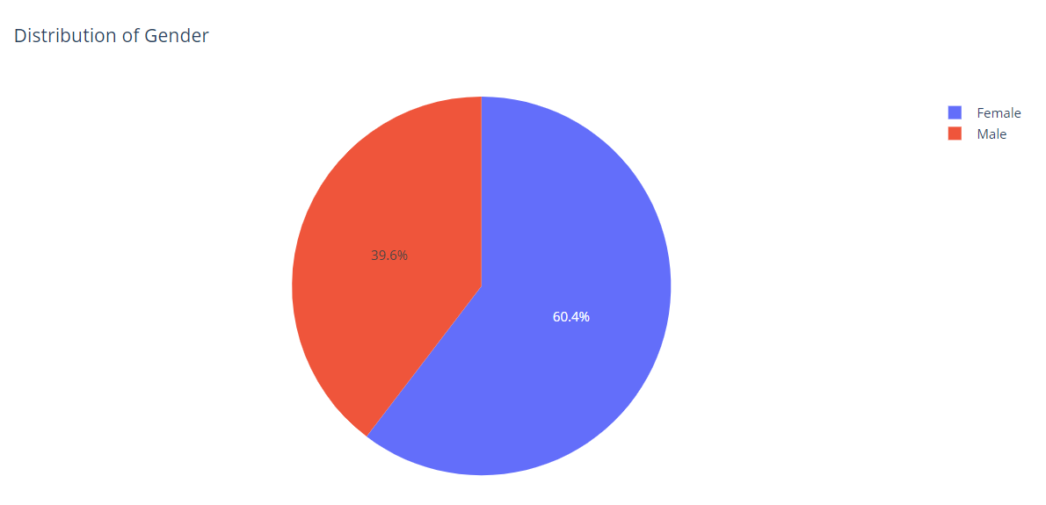
Exploratory Data Analysis
60.4% of the population is Female and 39.6% is Male.

Slide 8
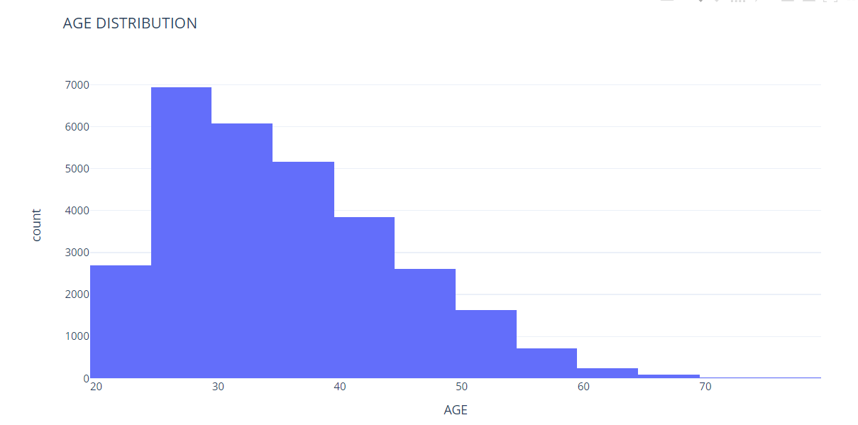
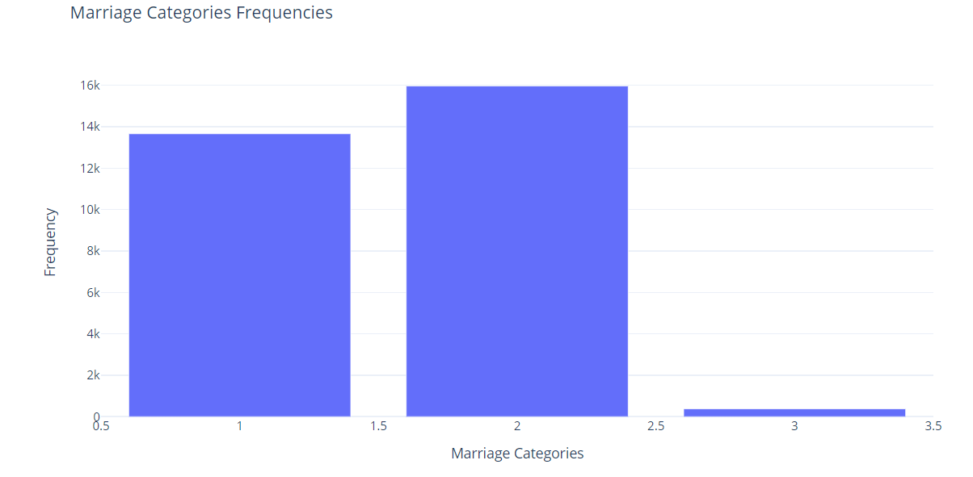
Exploratory Data Analysis
Median age of the customer 34 and mean is 35.4855.
Majority of the population is single (category ‘2’) then followed up by married people( category ‘1’).

Slide 9
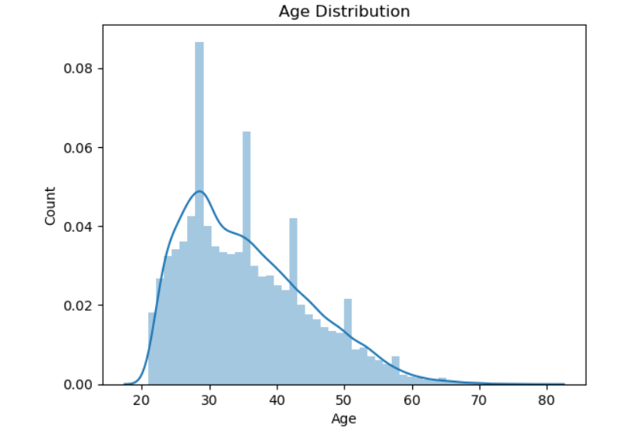
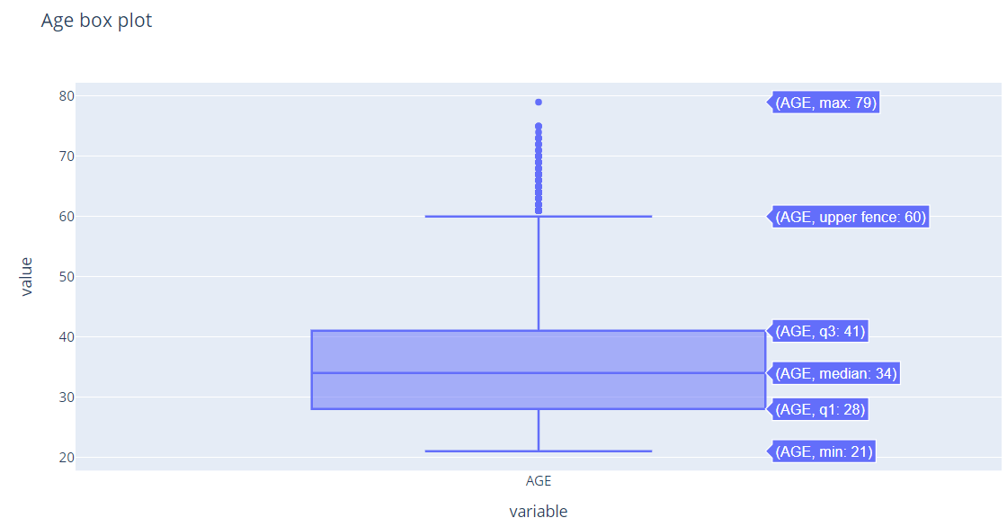
Data Cleaning
Outlier Detection and treatment
Approach is starting with visualization to get an initial understanding of the data and then applying numerical methods like z-scores or IQR for more precise identification.
Max age is 79, it is not a problem we are keeping the outliers.

Slide 10
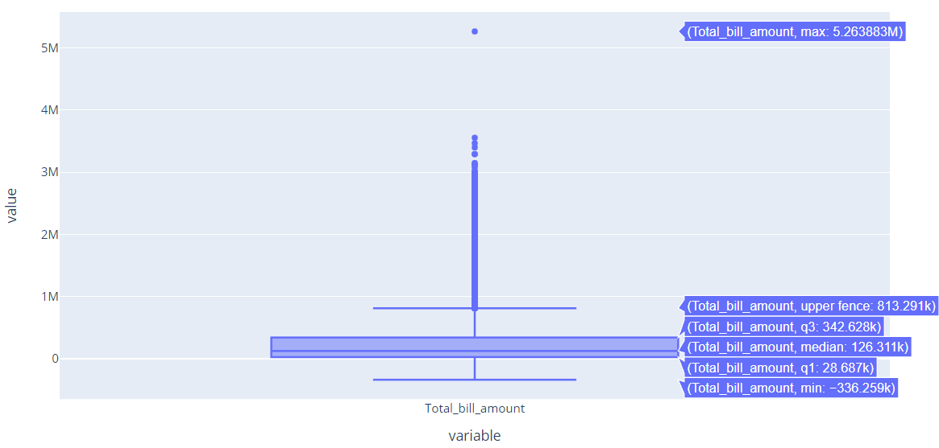
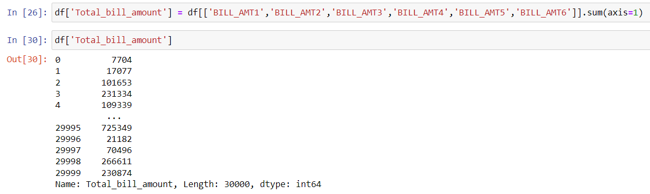
Feature Engineering
Aggregating ‘BILL_AMT’ columns to get a ‘Total_bill_amount’ for each individual.

Slide 11
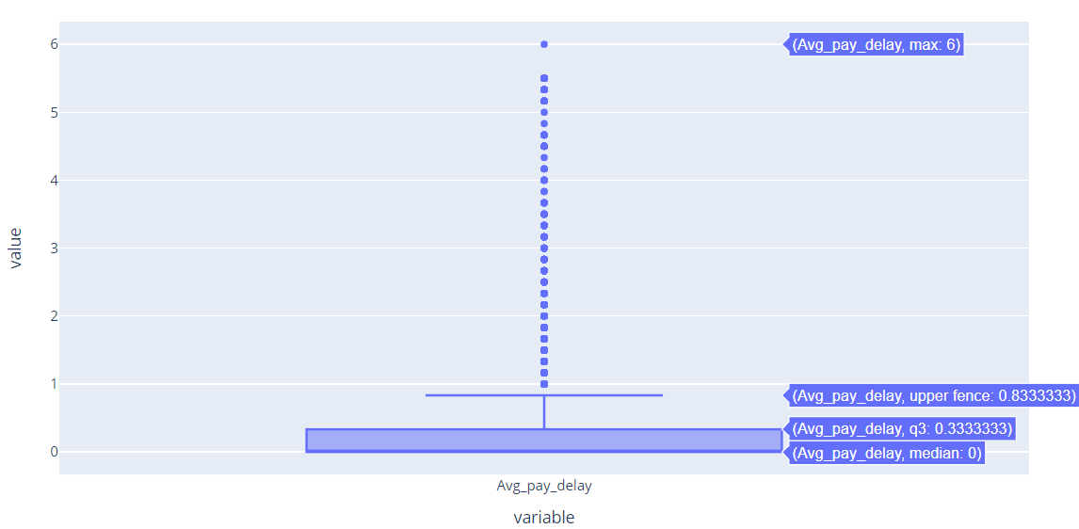
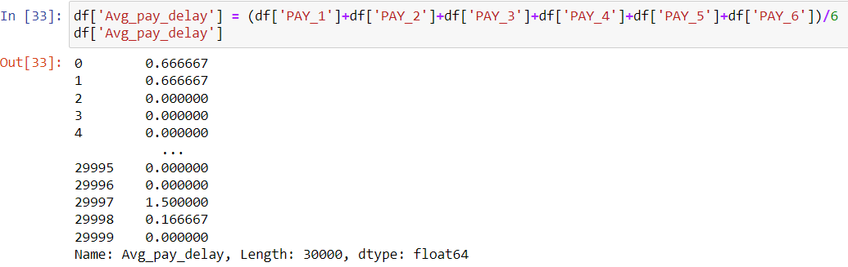
Feature Engineering
Aggregating ‘PAY_’ columns to get a ‘Avg_pay_delay’ for each individual. This shows new columns shows average month delay in repayment

Slide 12
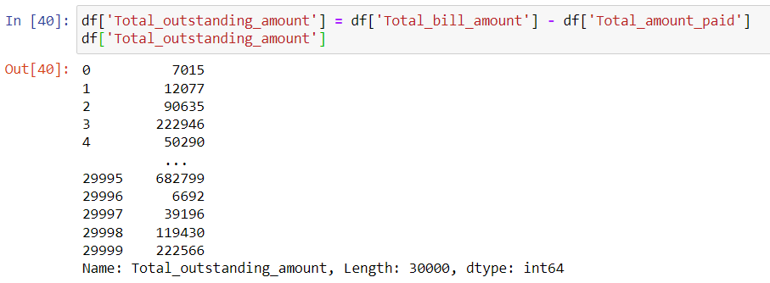
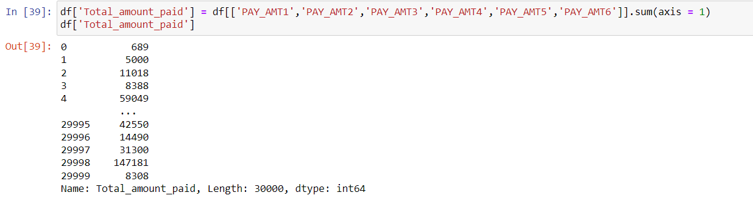
Feature Engineering
Similarly , new columns ‘Total_amount_paid’ and ‘Total_outstanding_amount’ are added .

Slide 13
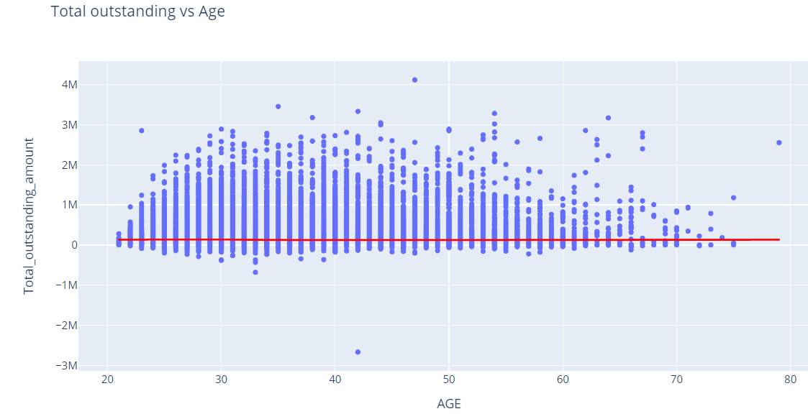
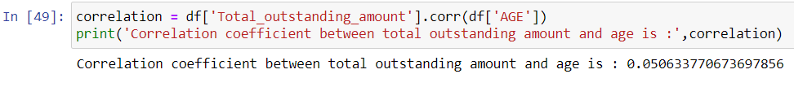
Data Analysis
Age vs Total outstanding amount: A correlation coefficient of 0.05 indicates a very weak positive linear relationship between the total outstanding amount and age columns. The value is close to zero, suggesting that there is almost no linear association between these two variables.

Slide 14
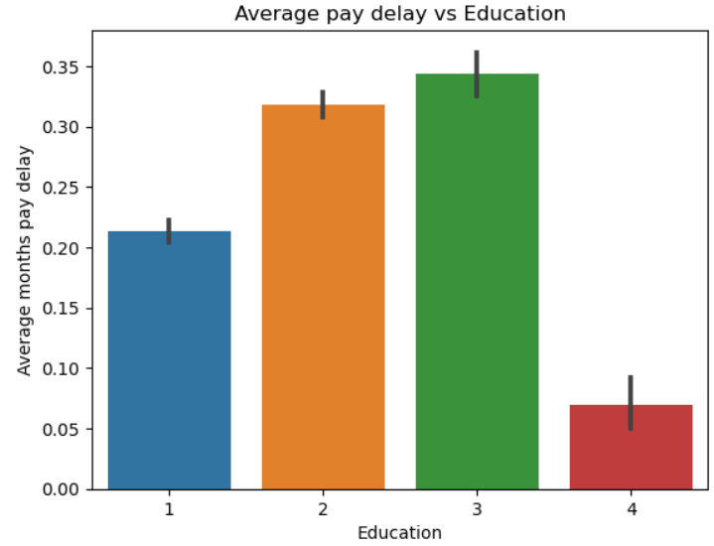
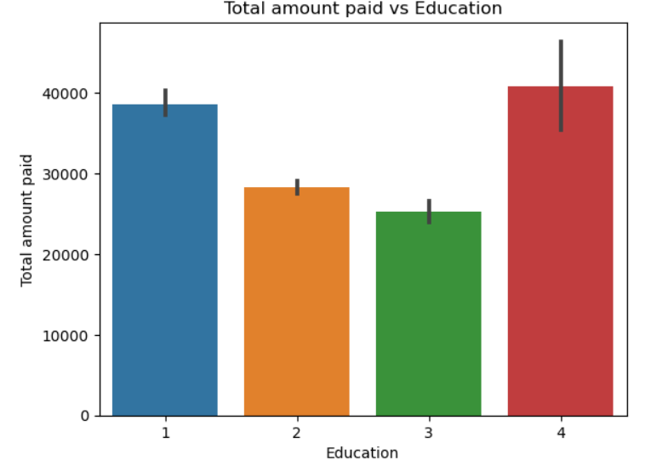
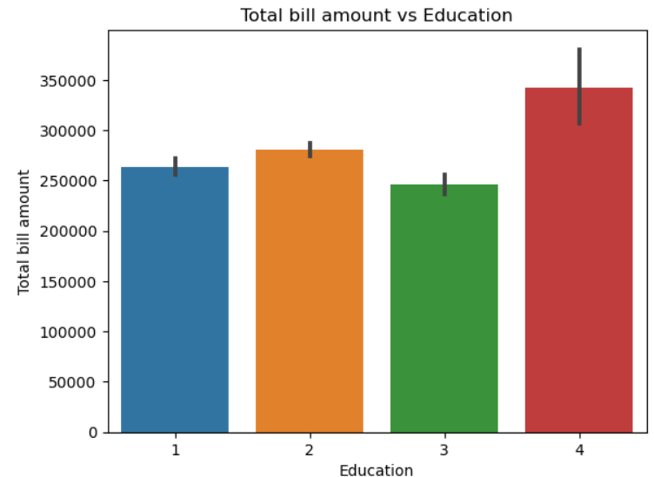
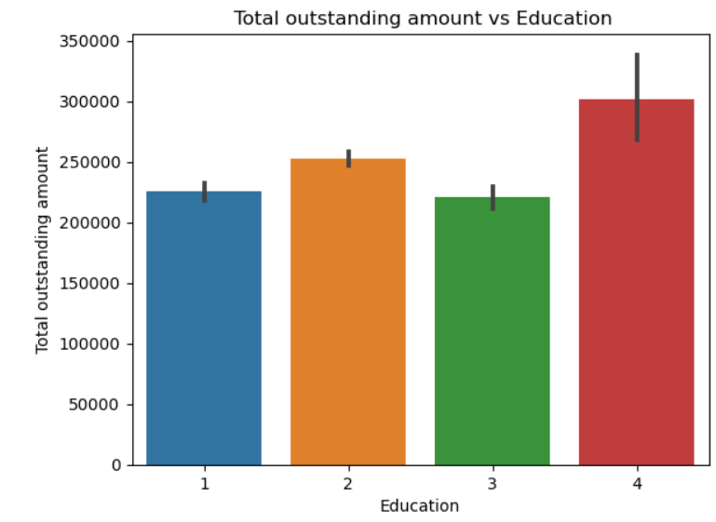
Data Analysis
High school students are more likely to delay payment.
Other category people although being less in number ,contribute more to outstanding amount.

Slide 15
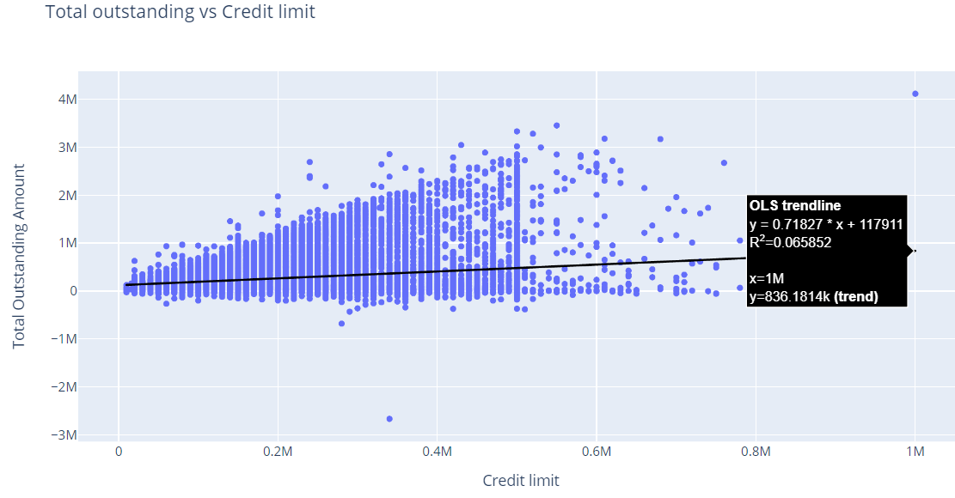
Data Analysis
Credit limit vs total outstanding amount

Slide 16
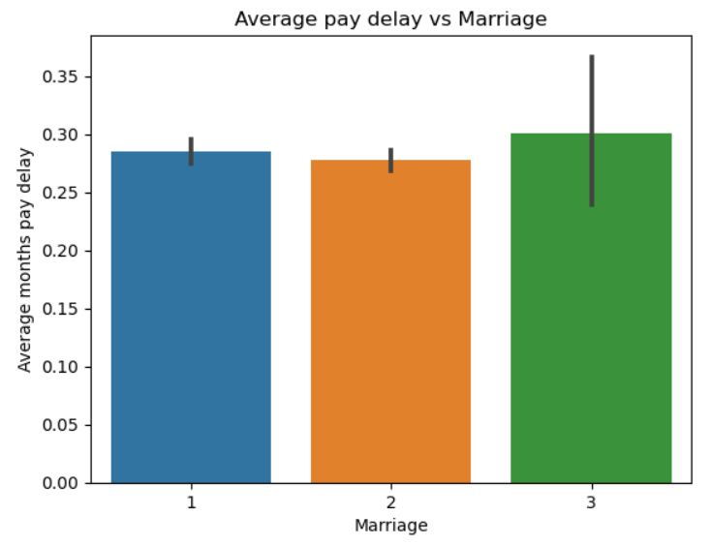
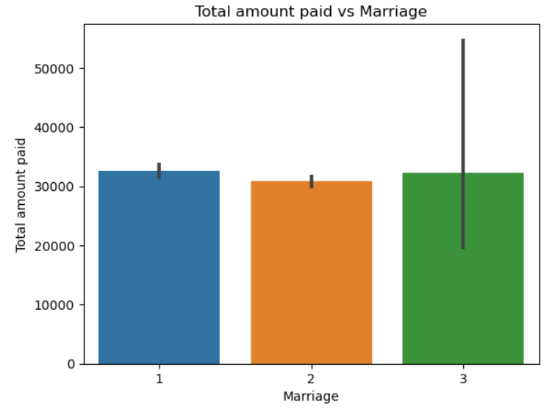
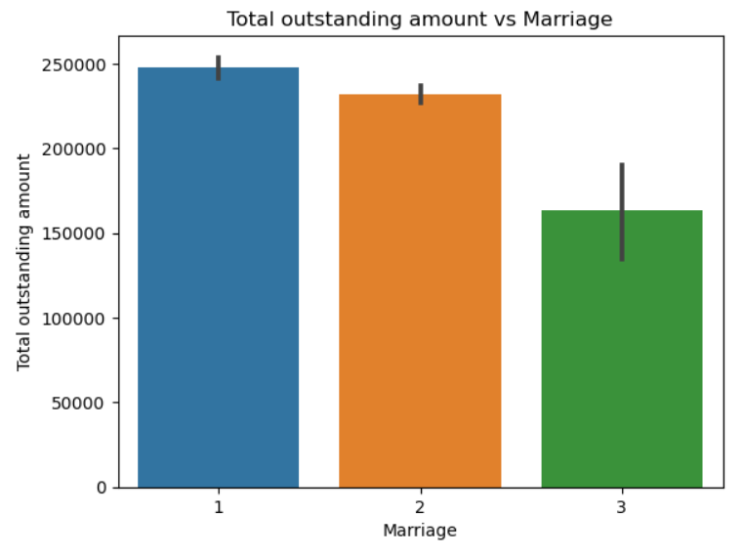
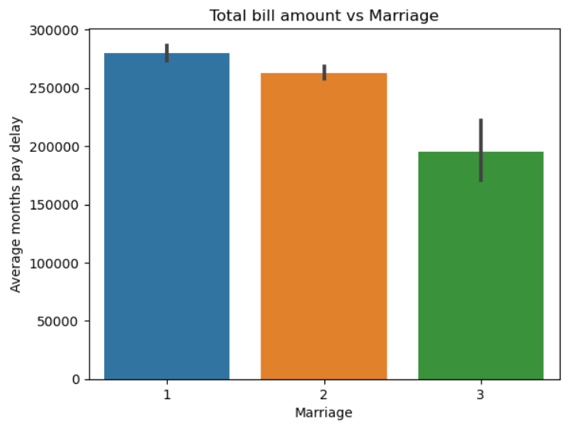
Data Analysis
People who are not married or single are paying more amounts of bill taking more time as compared to other categories.

Slide 17
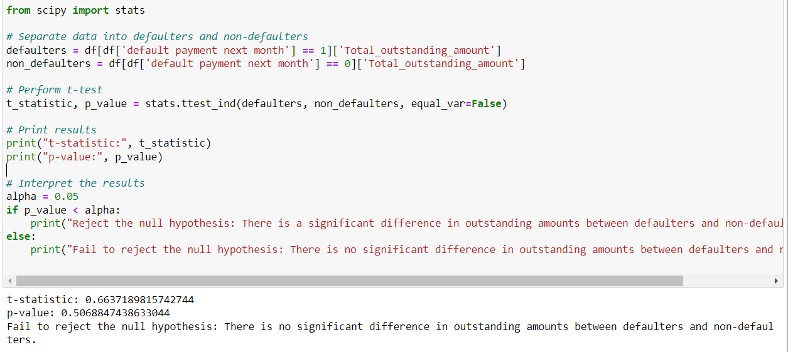
Statistical Analysis
Hypothesis Testing
Null Hypothesis (H0): There is no significant difference in outstanding amounts between defaulters and non-defaulters.
Alternative Hypothesis (Ha): There is a significant difference in outstanding amounts between defaulters and non-defaulters.
Result :
p value > significance value => Accept Null Hypothesis

Slide 18
Machine Learning Model Building
Encoding categorical variables
1
We already have categorical variable encoded in raw data .
Splitting data into features and target variables:
2
‘default payment next month’ is target variable.
Splitting data into train and test dataset
3
using train_test_split
Taking absolute of the input features:
4
We handled negative inputs by taking absolute of the features.

Slide 19
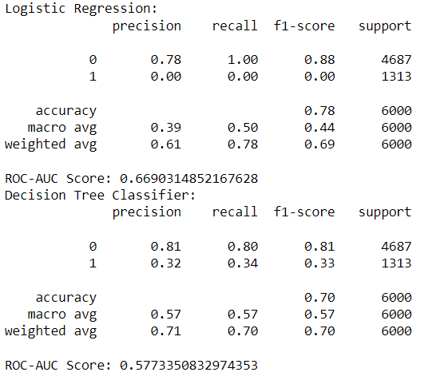
Machine Learning Model Building
5.Selecting best features:
We have lots of input features we are selecting best features using ‘SelectKBest’ as selector.
6.Scaling features (standard scaler):
Scaling features such that mean =0 and standard deviation =1.
7.Model building/Training:
LogisticRegression() and DecisionTreeClassifier() models.
8.Model Evaluation:
Prediction on scaled input test data. Classification report( f1 score, accuracy, precision etc.)

Slide 20
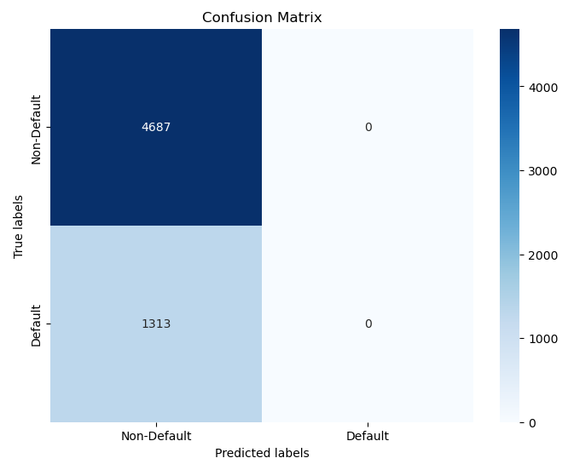
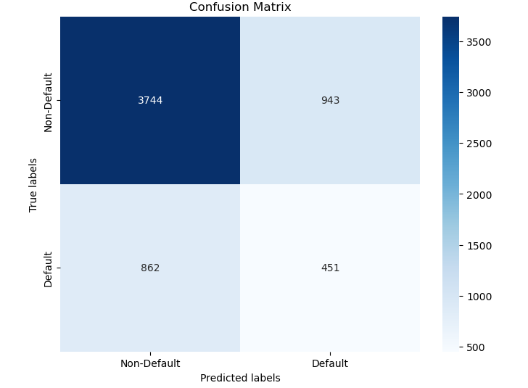
Confusion Matrix for classifiers
Logistic Regression Classifier
Decision Tree Classifier

Slide 21
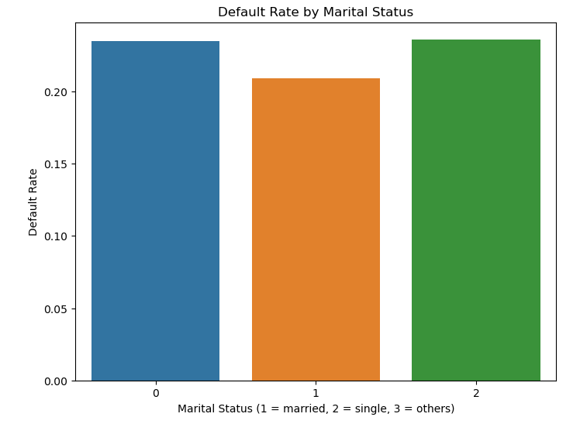
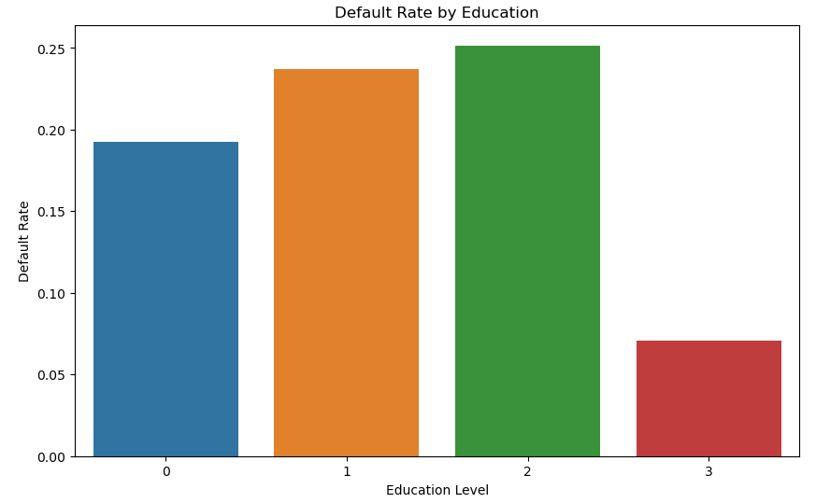
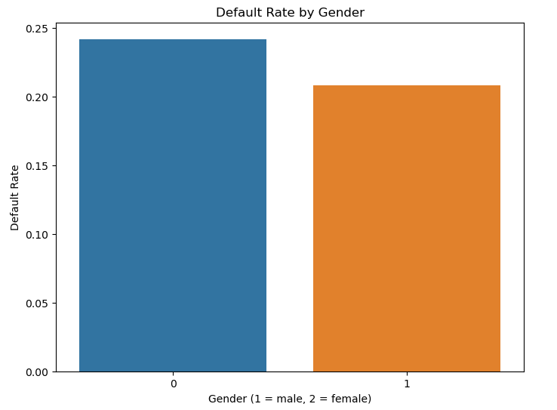
Key Insights
22% of the population belongs to defaulter class for the next month.

Slide 22
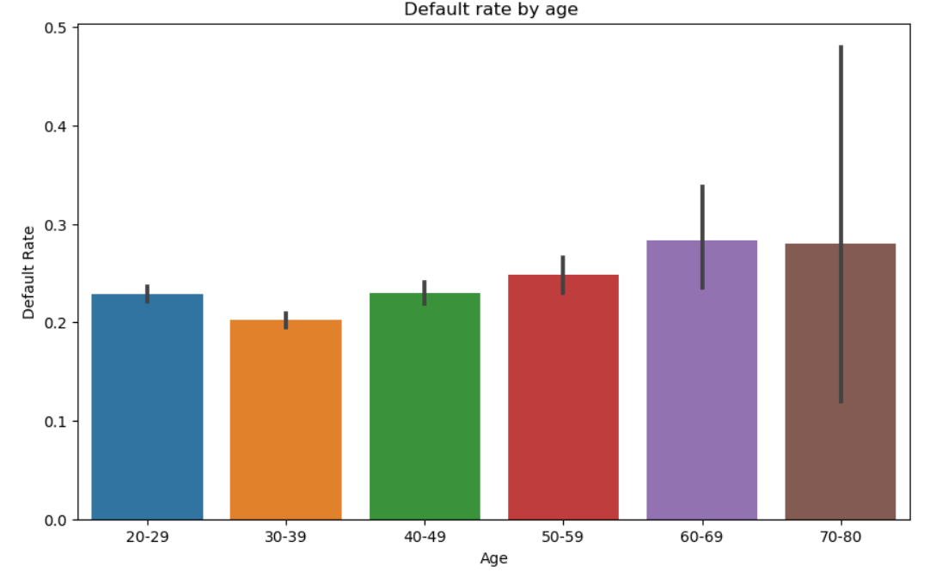
Key Insights
There is moderately strong correlation between the pay delay and a customer being defaulter for next month.

